Slide 1
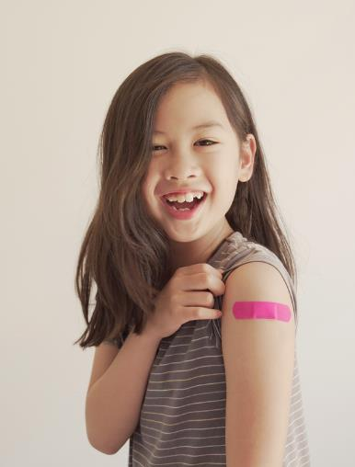


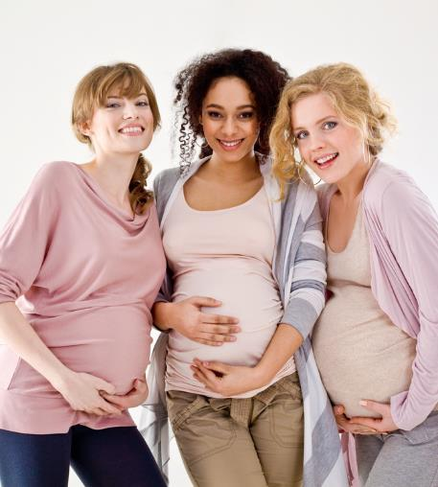
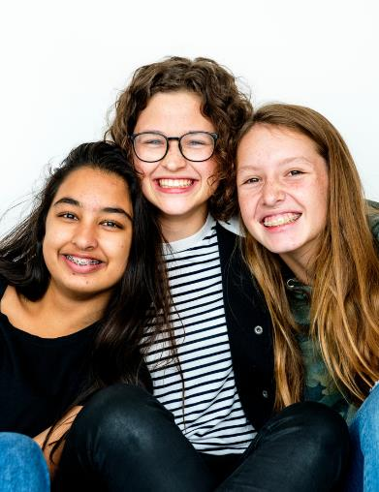

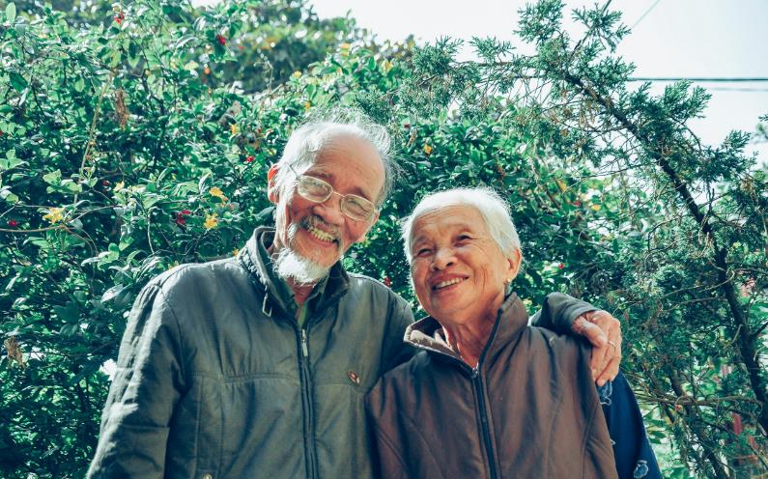
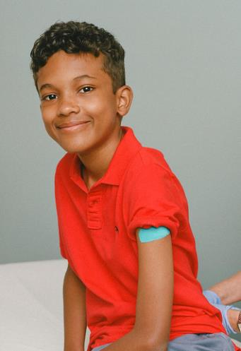
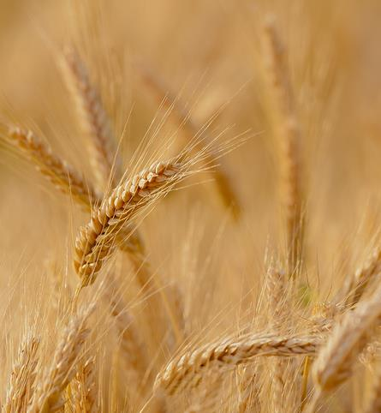


Protecting Kansans
WITH IMMUNIZATIONS

Slide 2




Immunizations are important and maintaining our state childhood vaccination policies is crucial to the health of children, pregnant women, and adults.
The vast majority of Kansans believe vaccines are important.
More than 90%
of Kansas voters support wellness vaccine requirements for children to attend schools/childcare.
Only a very small, vocal minority of adults want childhood vaccination to be optional.
Statistic from Nurture KC's Statewide Immunization Poll
bit.ly/353gLpw

Slide 3

Treating childhood vaccination as optional would be as dangerous as allowing people to treat traffic signals as optional.
Freedom is very important to all of us, but the safety of individuals in our community depends on a
balance between rights and responsibilities.

Slide 4
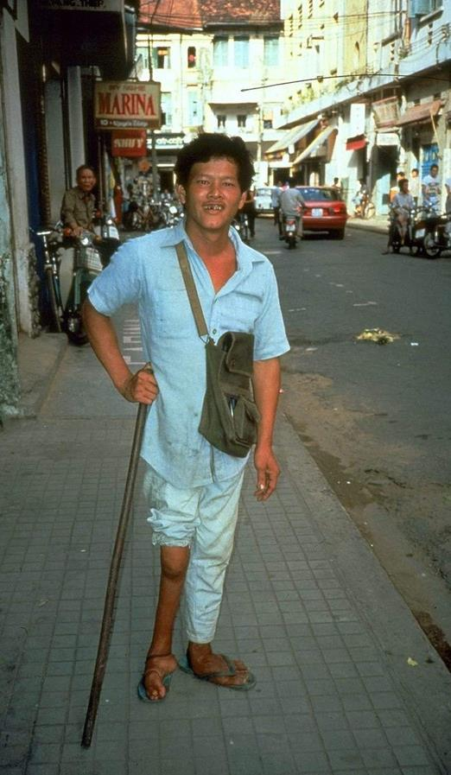

These infections have serious consequences.
  paralysis
  limb amputation
  hearing loss
  blindness
  seizures
  brain damage
  death
The notion that these diseases are “mild” is medically inaccurate.
Vaccine-preventable diseases cause permanent consequences such as:
The picture above shows a man with muscle wasting due to paralysis from polio)
Photo Source: https://en.wikipedia.org/wiki/Polio

Slide 5


These infections are still among us or are just a plane ride away.
  Vaccine-preventable diseases such as measles, mumps, and pertussis continue to infect U.S. children, resulting in hospitalizations and deaths every year.
  Tetanus spores are in the soil and will never be eradicated.
  Some of these diseases are abroad. If children are not vaccinated, they could easily be infected from contact – even indirect contact – with a traveler.
95% of Kansans
believe taking vaccines for such diseases as measles, mumps and polio is “extremely” or “very important” to maintaining good health.
Statistic from Nurture KC's Statewide Immunization Poll
bit.ly/353gLpw

Slide 6
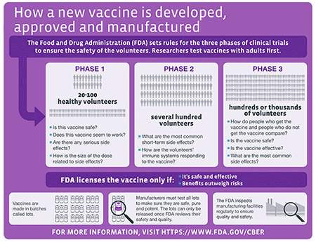
U.S. vaccine safety standards are high.
  Before being licensed in the U.S., scientists, doctors, and the federal government carefully review the data in phases to make sure the vaccines are safe.
  The FDA licenses vaccines only after randomized controlled trials; then there is continuous monitoring after licensure.
  Standards are high because vaccines are given to healthy people.
Source: CDC

Slide 7



Vaccines Save Lives
We know that vaccines have eliminated or dramatically reduced the incidence of many infectious diseases.
Experts around the world agree on this.
In the U.S. giving children born in a single year all routine vaccines can prevent 42,000 early deaths and 20 million cases of disease.
Source: bit.ly/2YvAbNL
Vaccines also save money.
Every $1 spent on childhood vaccines saves $10.
Source: bit.ly/2BdDW1o

Slide 8
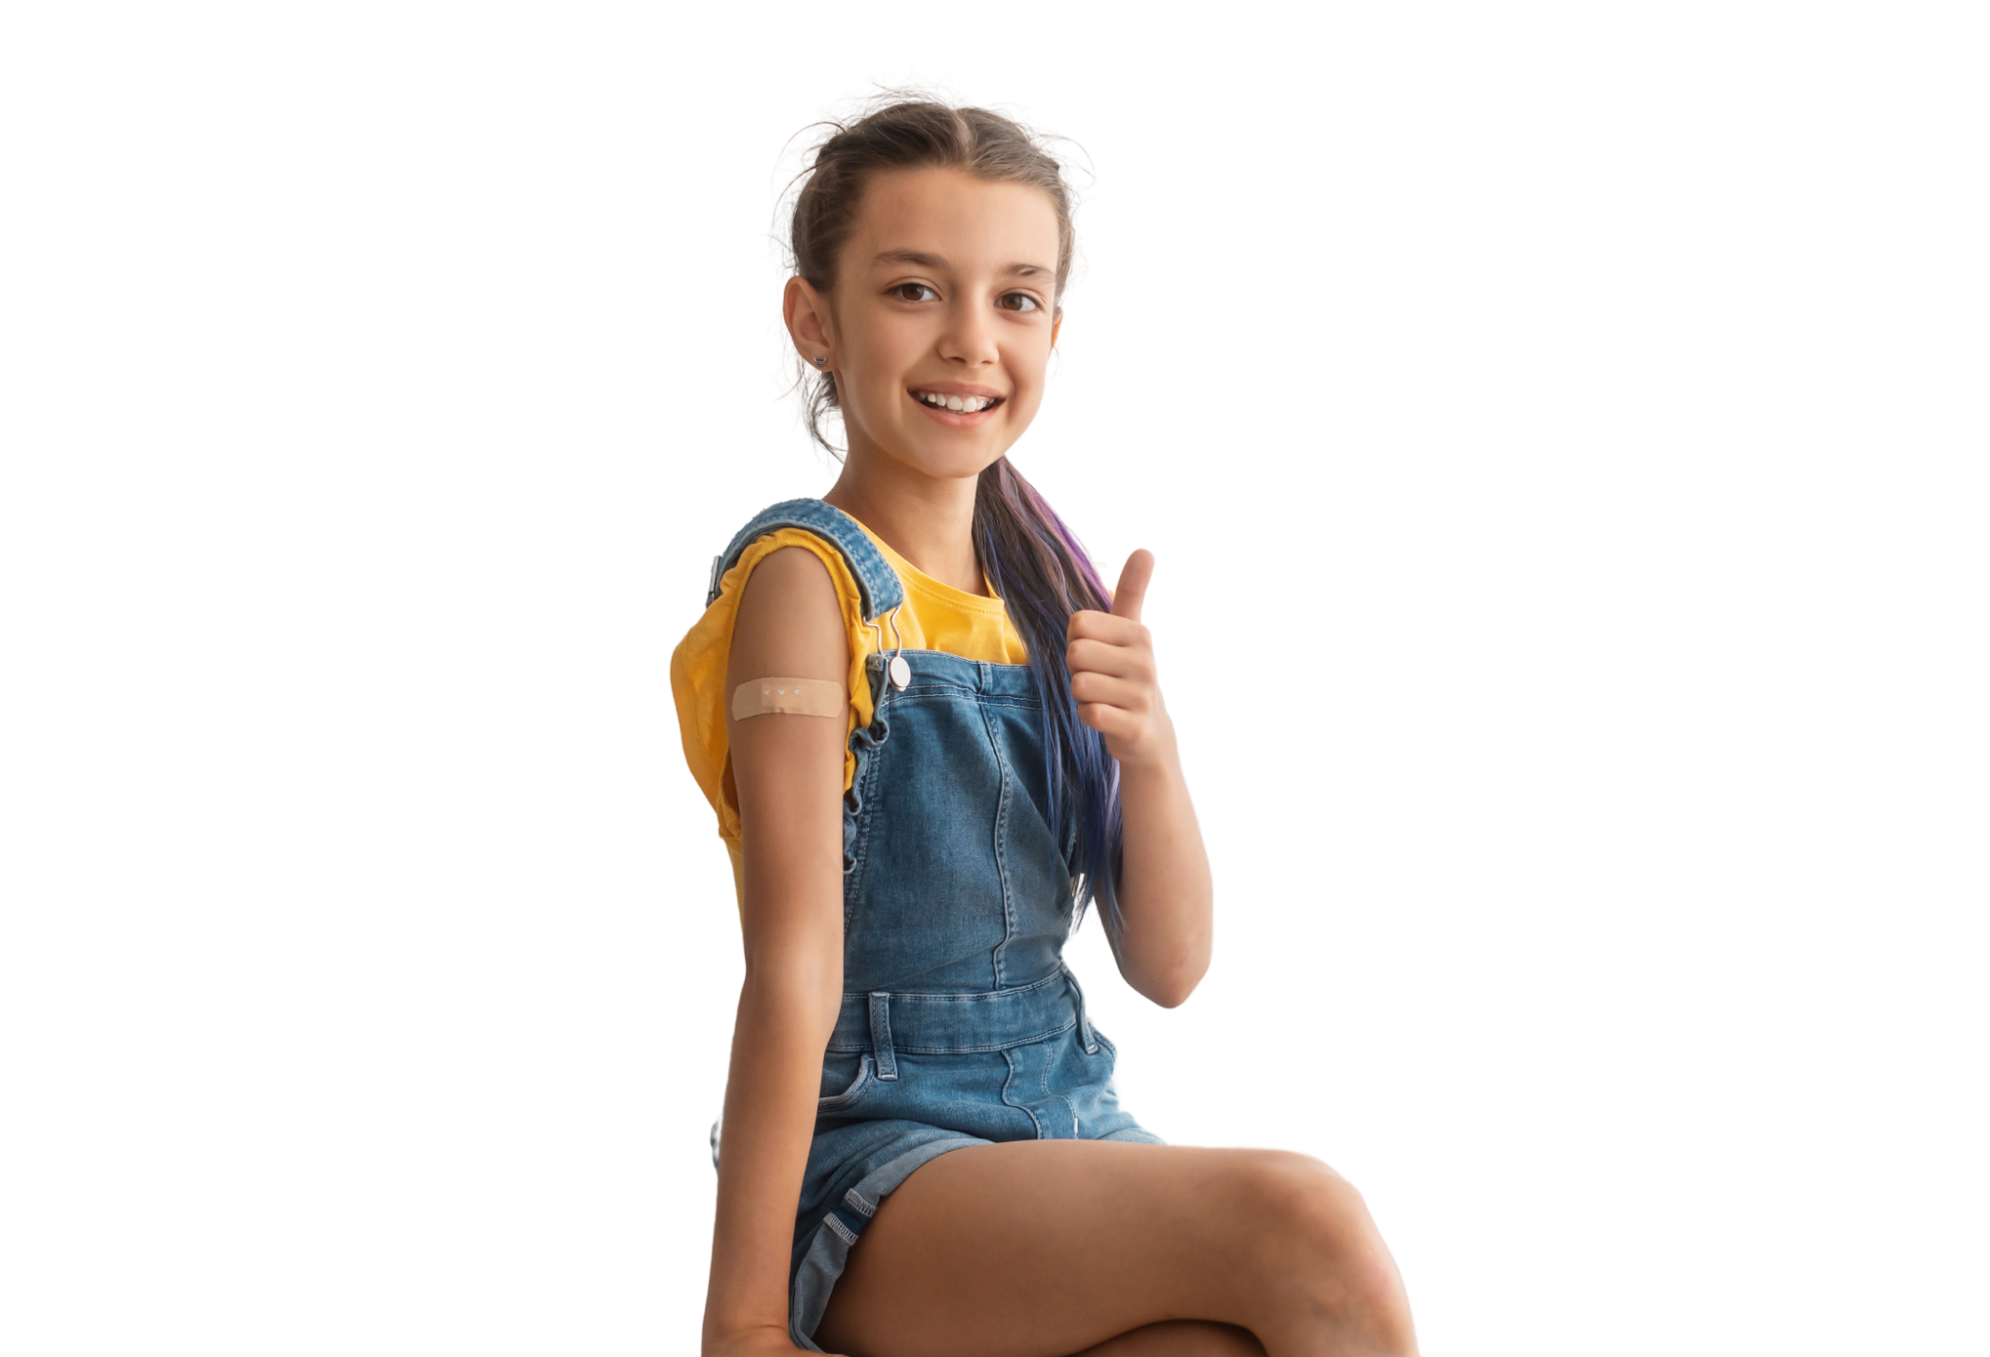
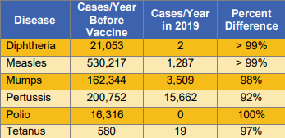
Let’s keep improving, not go backwards.
The decrease in vaccine-preventable diseases is enormous since vaccines became available!
In the table above, for each disease you see the difference between the number of people in the U.S. who became sick per year before the vaccine versus in 2019.

Slide 9
Take a guess…
Which statements are true?
We have medicine to treat some vaccine-preventable disease (e.g. pertussis), but not most (e.g. mumps, diphtheria, polio).
Some bacteria and viruses have developed resistance to medicines.
The primary benefit of vaccination is protection for the vaccinated child.
When enough children are vaccinated, we also develop community immunity.

Slide 10

Take a guess…
Which statements are true?
We have medicine to treat some vaccine-preventable disease (e.g. pertussis), but not most (e.g. mumps, diphtheria, polio).
Some bacteria and viruses have developed resistance to medicines.
The primary benefit of vaccination is protection for the vaccinated child.
When enough children are vaccinated, we also develop community immunity.

Slide 11
Take a guess…
Which statements are true?
We have medicine to treat some vaccine-preventable disease (e.g. pertussis), but not most (e.g. mumps, diphtheria, polio).
Note that while the primary benefit of vaccination is protection for the vaccinated individual, when enough children are vaccinated, we also develop community immunity.
In fact, vaccinations - and the regulations that require them – protect individuals AND communities as a whole.
Some bacteria and viruses have developed resistance to medicines.
The primary benefit of vaccination is protection for the vaccinated child.
When enough children are vaccinated, we also develop community immunity.

Slide 12

Did you know? Aluminum in vaccines increases their effectiveness.
Play the video below to hear more about why aluminum in vaccines is safe. (2 minutes 17 seconds)

Slide 13



Aluminum
Aluminum is abundant – making up almost 9% of the earth’s crust.
It's in plants, soil, water and air.
It's in foods and beverages including fruits and vegetables, nuts, seasonings, flour, cereals, dairy products, baby formulas, and honey.
Aluminum has been used to boost the immune response to the vaccine since the 1930s. Of course, vaccines containing aluminum are tested extensively in clinical trials before being licensed.

Slide 14

Aluminum
How much is too much?
The quantities of aluminum in vaccines are low. The aluminum contained in vaccines is similar to that found in a liter (about 1 quart) of infant formula.
Typically, adults ingest 7 to 9 milligrams* of aluminum per day.
In the first 6 months of life, infants get about 4.4 milligrams of aluminum from vaccines in total. During those months, they receive more than that in their diet.
Breast-fed infants ingest about 7 milligrams
Formula-fed infants ingest about 38 milligrams
Soy formula-fed infants ingest almost 117 milligrams
*1 milligram is 1-thousandth of a gram.
1 gram is the weight of 1-fifth of a teaspoon of water.

Slide 15

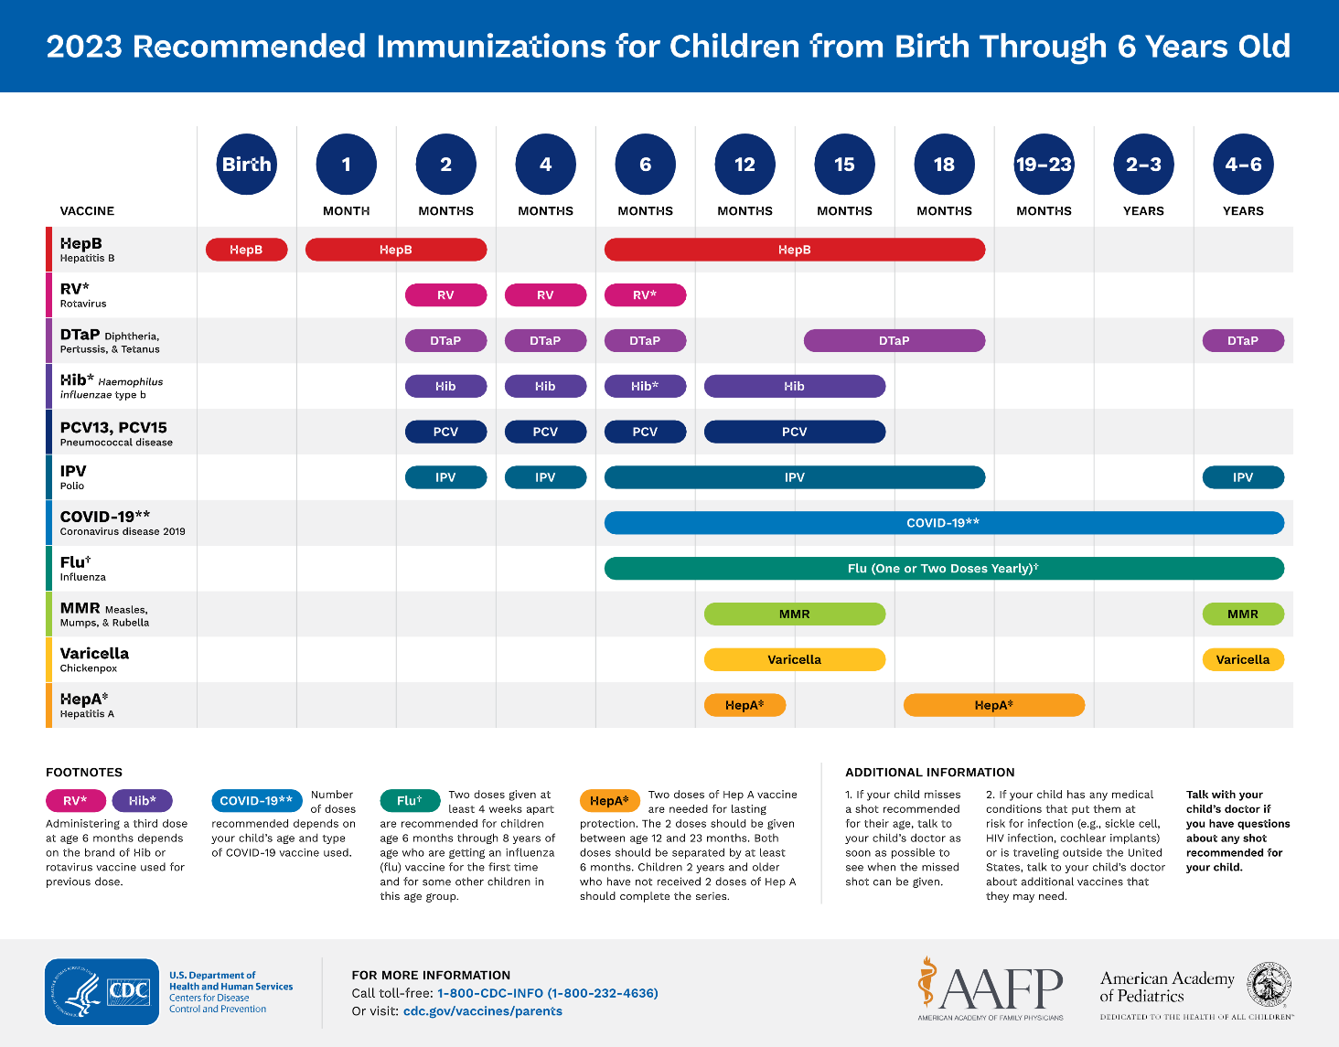
Kids today get more vaccinations because there are more vaccines available to prevent serious and sometimes deadly diseases.
Today’s vaccines are smarter vaccines – they get a stronger immune response with fewer components in the vaccines than previous vaccines.
There are no side effects from giving several immunizations at the same time.

Slide 16

Two cell lines currently used in vaccines are derived from elective abortions performed in Europe in the 1960s. Since that time, the cell lines have been maintained in the laboratory. No further sources of fetal cells are necessary.
Currently, the vaccines that are made in human cells are:
Varicella (chickenpox)
Rubella (German measles)
Hepatitis A
Rabies vaccine – the version known as Imovax®
The Christian Medical and Dental Associations position is this: “Using technology developed from tissue of an intentionally aborted fetus, but without continuing the cell line from that fetus, may be morally acceptable.”
Catholic Church reviews of this, by both the Vatican’s Pontifical Academy for Life and the National Catholic Bioethics Center, have determined that use of vaccines grown in these cell lines do not defy the religion’s doctrine.

Slide 17
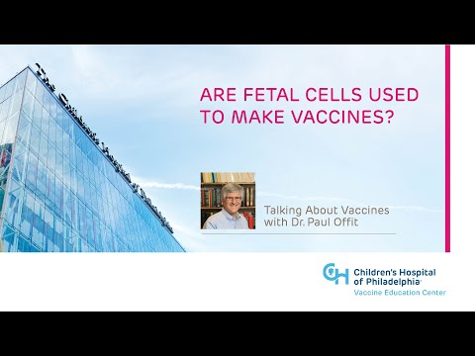

Slide 18


The Autism Science Foundation (ASF) is a non-profit group, started by parents of autistic children. Here is what they say about vaccines:
"A decade ago most researchers agreed that we needed to study vaccines in relation to autism.
...
We looked at children who received vaccines and those who didn’t, or who received them on a different, slower schedule. There was no difference in their neurological outcomes.
Multiple studies have been completed which investigated the measles, mumps and rubella vaccination in relation to autism.
...
The results of studies are very clear; the data show no relationship between vaccines and autism."
Notes:
ASF provides information about autism to the general public and serves to increase awareness of autism spectrum disorders and the needs of individuals and families affected by autism.
Full Quote: "A decade ago most researchers agreed that we needed to study vaccines in relation to autism. We had to reconcile the fact that the number of vaccines children were receiving was increasing, and at the same time, the number of children who were being diagnosed with autism also was on the rise.
Fortunately this was a question that could be studied – and answered – by science
We looked at children who received vaccines and those who didn’t, or who received them on a different, slower schedule. There was no difference in their neurological outcomes.
Multiple studies have been completed which investigated the measles, mumps and rubella vaccination in relation to autism.
Researchers have also studied thimerosal, a mercury-based preservative, to see if it had any relation to autism.
The results of studies are very clear; the data show no relationship between vaccines and autism."

Slide 19

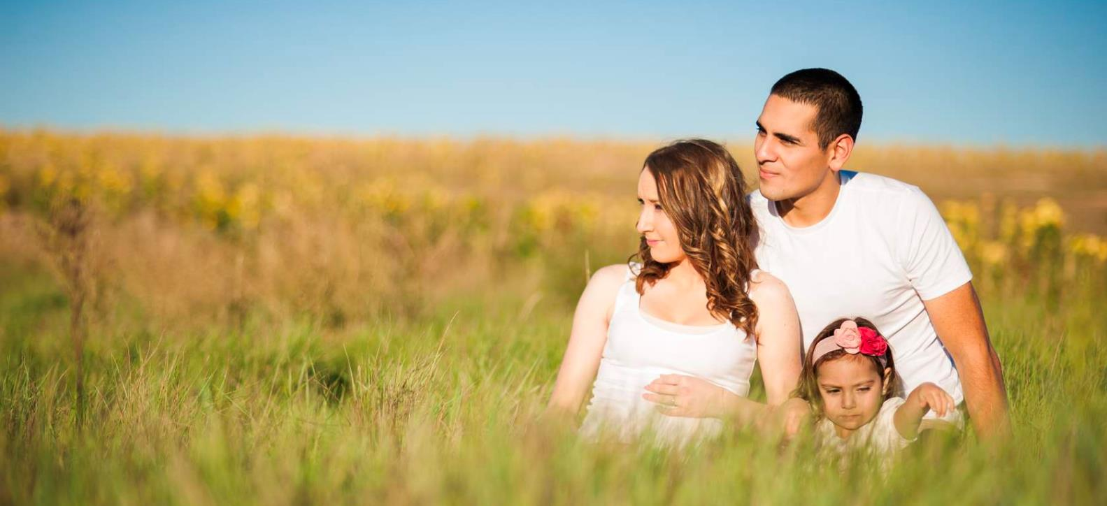
We are not just healthcare providers and public health officials, we are parents too, and we vaccinate our children, and ourselves to protect against disease.
Because we care about every child’s health, we chose these professions.
We have seen that vaccination is the best way to protect every child against diseases that can be prevented.

Slide 20
Answers to 2 Common Questions
Question 1:
Is the aluminum in vaccines safe?
Yes, aluminum is the third most common element on Earth. It's in plants, soil, the air, and many daily foods and beverages.
During the first 6 months of life, a breastfed infant will take in more aluminum through their diet than via recommended vaccinations.
Question 2:
Are fetal cells used to make vaccines?
Vaccines do not contain aborted fetuses.
In the 1960s, scientists used fetal cells to develop cell lines to grow certain viruses used in vaccines. Though these cell lines are still used today, no vaccines use cells directly from aborted fetuses. Bioethicists at the National Catholic Bioethics Center have considered this and concluded vaccination is permitted because it protects the life and health of children and those around them.

Slide 21


Key points about Kansas' current childhood vaccination policies
A child with a medical exemption from vaccination can still attend school.
  In order to attend school, such children simply need a physician-signed certificate stating that a medical condition prohibiting vaccination is currently present.
  Because there are children who are medically unable to get vaccinated and vulnerable to these vaccine-preventable diseases, it is very important that every else who can get vaccinated does to help create community immunity.

Slide 22


Evidence supports school regulations.
  Evidence shows that if non-medical exemptions are easy to obtain, exemptions increase and vaccination coverage decreases.
  In turn, this increases the risk for outbreaks of vaccine-preventable disease.
Let's maintain our childhood vaccination policies to keep our school and our whole community safe!
State regulations recognize that if too many people go without vaccination the spread of dangerous viruses or bacteria could increase dramatically, threatening the public with disease outbreaks.
Source: nejm.org/doi/full/10.1056/NEJMc1209037
85% of Kansas voters
believe the Kansas Department of Health and Environment (KDHE) is the appropriate entity to set wellness vaccine policy for children in Kansas.
Statistic from Nurture KC's Statewide Immunization Poll
bit.ly/353gLpw

Slide 23







We stand together in making this strong recommendation for vaccination.
Our state organizations all strongly support vaccination programs validated by science. This includes, for example:
  Kansas School Nurse Organization
  Kansas Medical Society
  Kansas Cancer Partnership
  Kansas Chapter American Academy of Pediatrics
  Kansas Academy of Family Physicians
  Kansas Hospital Association
For physicians, vaccinating isn’t about profit;
it’s part of giving quality care.

Slide 24
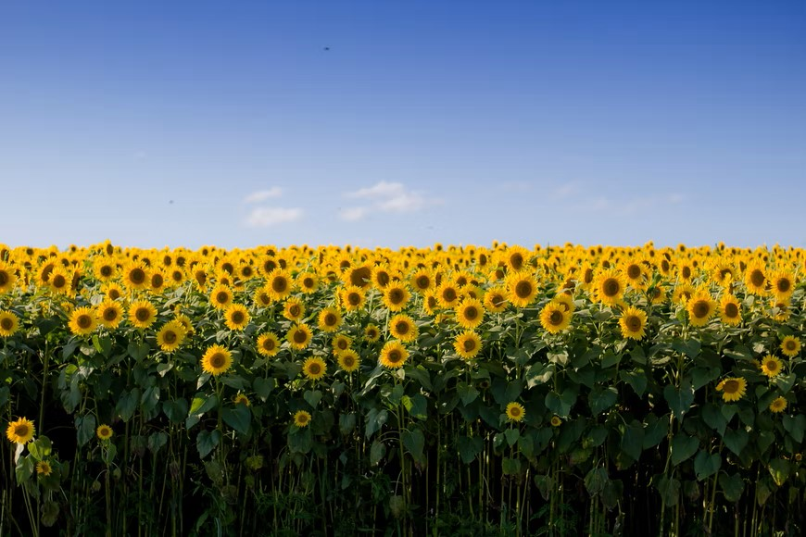
We are about prevention for all Kansans!
  It is important to listen to the vast majority of Kansans who want protection based on medical science.
  Scientific evidence is not as showy as a protest or as trendy as what’s shared on social media, but we must give the scientific evidence our careful attention.
  It’s crucial to protect all individuals in Kansas with the proven benefit of vaccination.
Vaccines are about healthy individuals, healthy communities, and reducing the impact of vaccine-preventable disease, which transcends partisanship.

Slide 25
Recommend Resources
Kansas Immunization Program
kdheks.gov/immunize
Immunize Kansas Coalition
immunizekansascoalition.org
Immunization Action Coalition
immunize.org
Children’s Hospital of Philadelphia, Vaccine Education Center
chop.edu/centers-programs/vaccine-education-center
Stronger.org, How to Spot Misinformation

